Slide 1
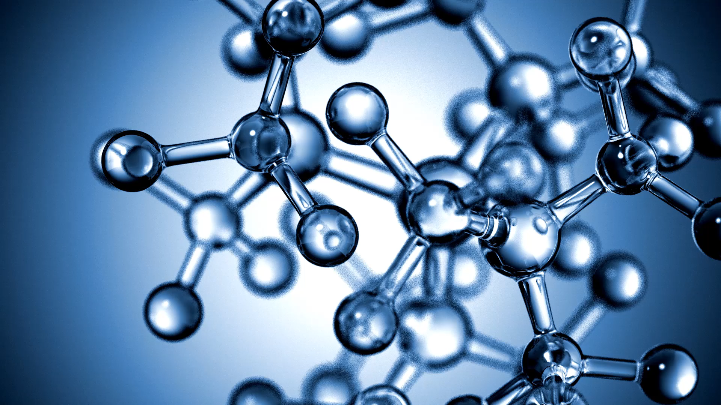
Reapplying Genetic Algorithms
By: Robert Powell

Slide 2
Project Goals:
Personally investigate if genetic algorithms could be used to solve other types of problems by implementing one to solve sudoku.

Slide 3
Background information: What are Genetic Algorithms?
Genetic algorithms are a class of algorithms modeled after evolution.
A seed population of solutions is randomly generated.
These solutions are then ranked on their “fitness”, which serves as an indicator as to how close a solution is to being an actual solution.
The best of the solutions is then recombined with each other and randomly altered at a low rate.
The newly generated solutions are ranked again and if no actual solution is found amongst them, the recombination process begins again.

Slide 4
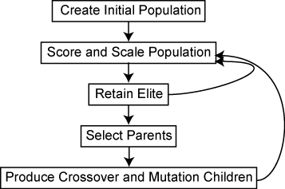

Slide 5
Background information: What is sudoku.
Sudoku is a puzzle game which consists of a 9x9 grid.
The goal of the game is to have each of the 9 columns, rows, and sub grids filled with the numbers 1 through 9 with out repeating any numbers.
Some of the squares are already filled with numbers as clues.

Slide 6
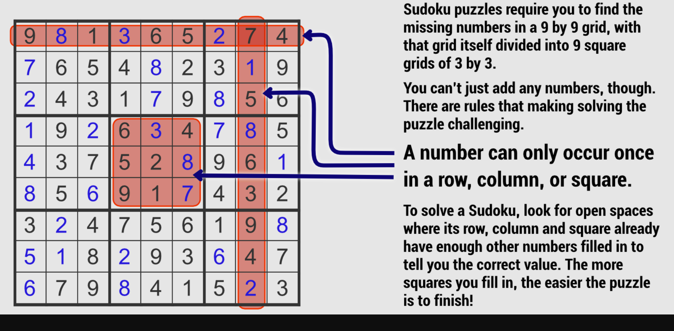

Slide 7
Plan to achieve project goals.
Reengineer the 8-queen program built earlier this semester to solve sudoku puzzles.

Slide 8
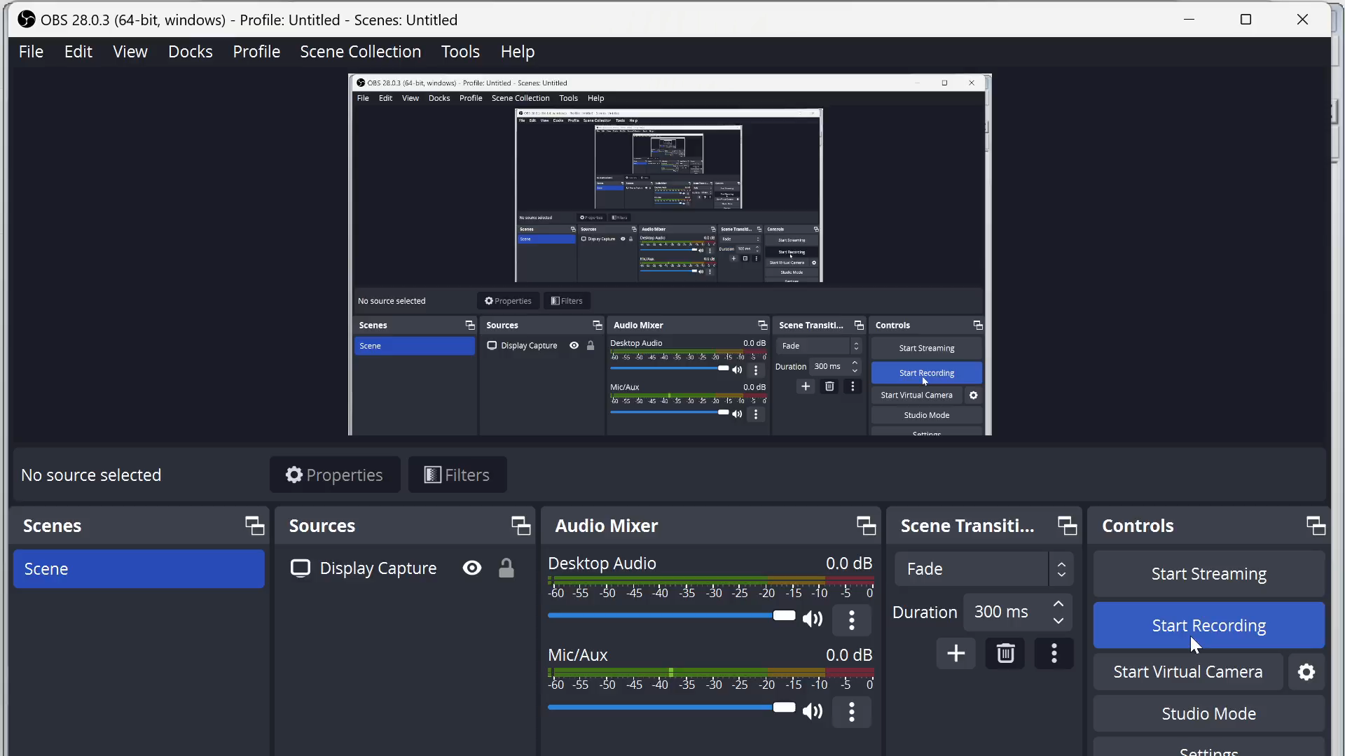

Slide 9
Challenges Faced – Inadequate grid design
The original 8 queens program contained an 8x8 grid for displaying results. So, I had to convert the 8x8 grid into a 9x9 grid. Additionally, I had to create 9 3x3 sub grids.

Slide 10
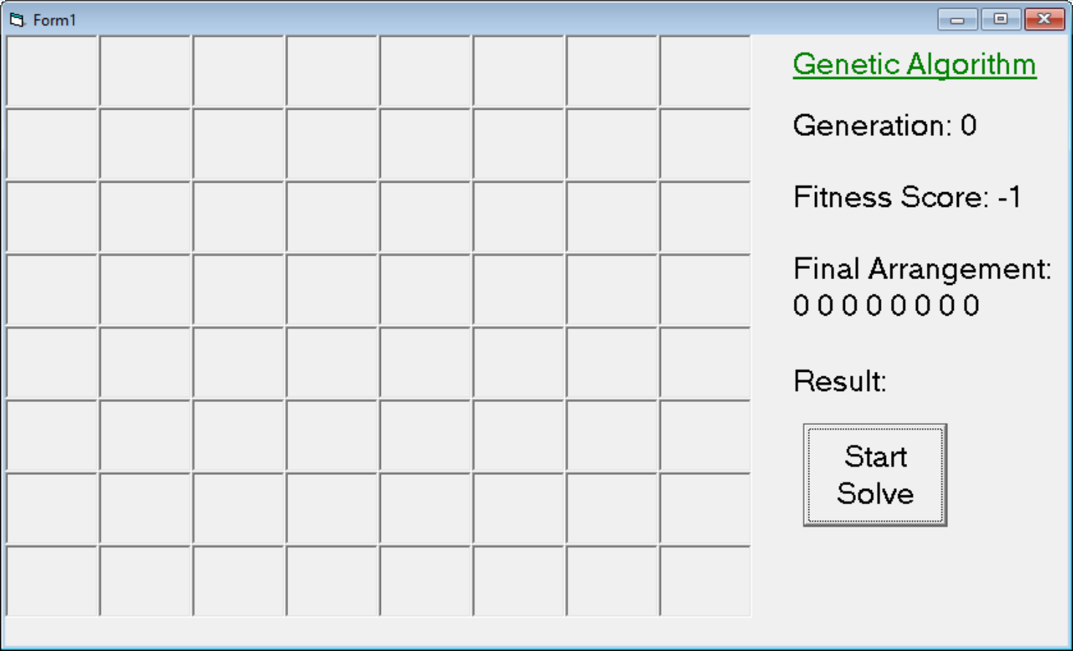

Slide 11
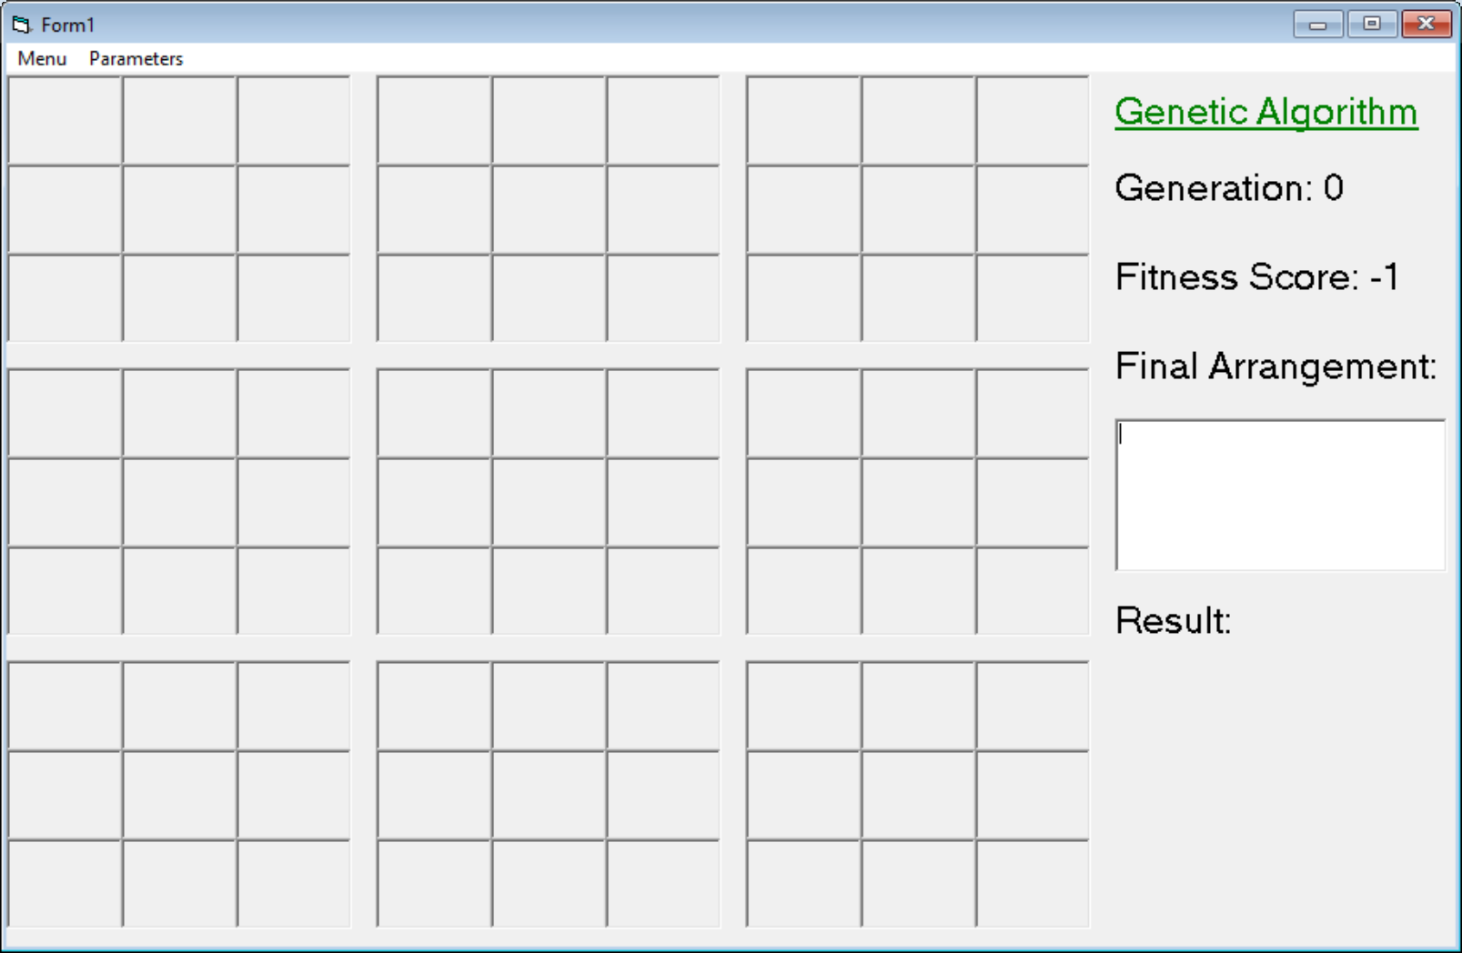

Slide 12
Challenges Faced – Inadequate method checking generated solutions.
The original 8 queens program checked diagonals, rows, and columns for duplicate “Q” characters in order to evaluate solutions. This method was unsuitable for sudoku puzzles. So, I had to redesign the solution checking mechanism to analyze rows, columns, and sub grids for arrangements which violate the winning conditions for sudoku. Each violation found adds points against a solution’s fitness.

Slide 13
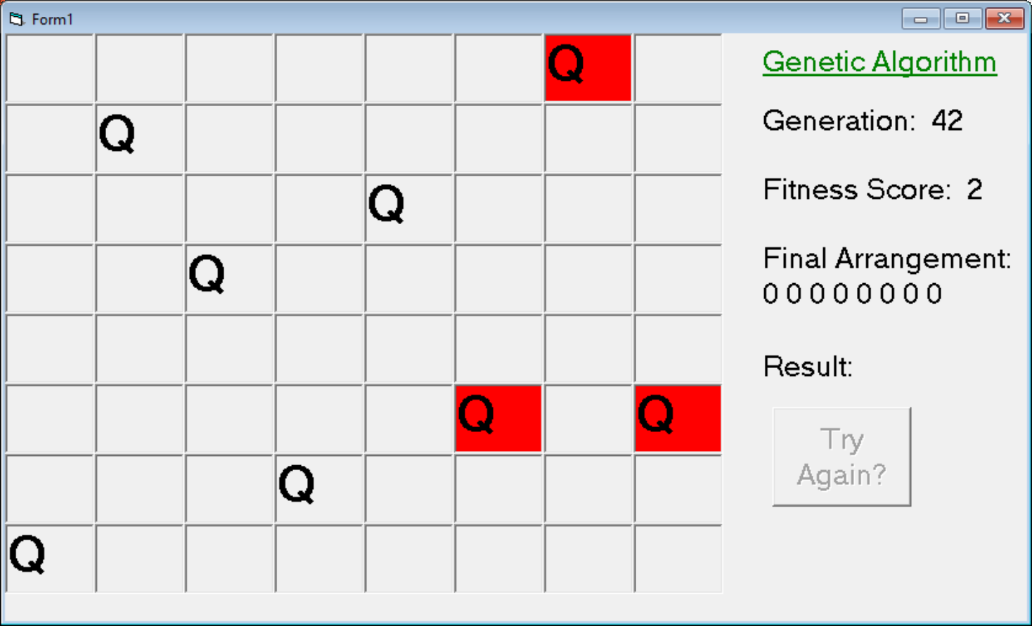

Slide 14
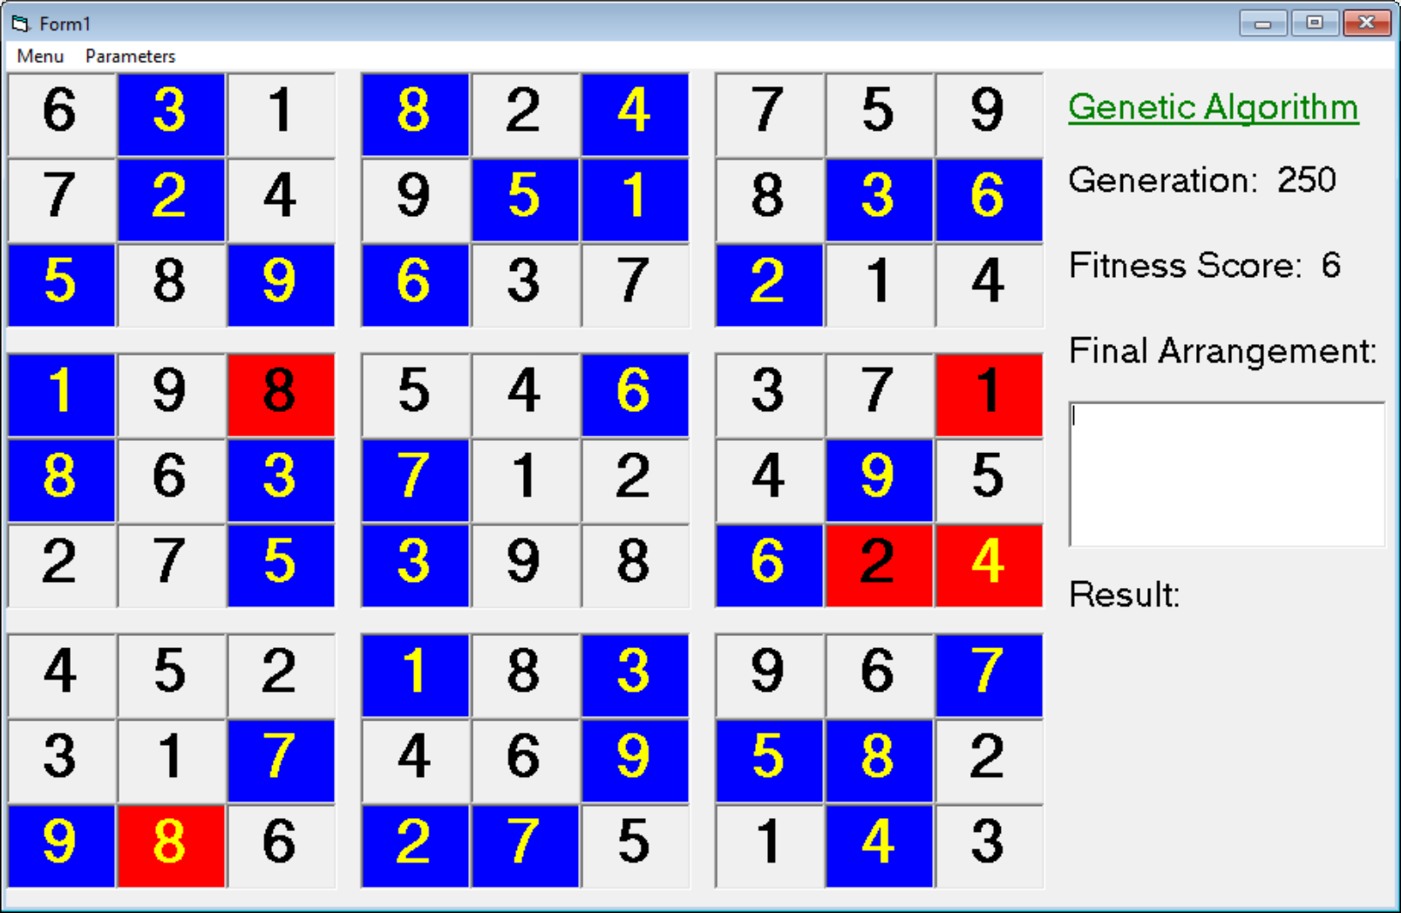

Slide 15
Challenges Faced – Inadequate method of evaluating fitness.
The original 8 queens program used a lax interpretation of genetic algorithms to solve the 8 queens problem. Solutions weren’t ranked and only the best solution of each generation was crossed with the others. Also, the removal of poor solutions was somewhat arbitrary.
The redesigned genetic algorithm present in the sudoku solver actually ranks generated solutions and keeps a certain number of them. Also, the crossing of solutions is much more diverse. The mutation rate was also increased from 5 to 15 percent

Slide 16
8 Queens Crossing Method
Solution Representation in next generation is not proportional to the ranking of the solution.
Unranked Solution 1
Unranked Solution 2
Unranked Solution 3
Unranked Solution 4
Top Solution
Sudoku Crossing Method
Solution Representation in next generation is proportional to the ranking of the solution.
Ranked Solution 1
Ranked Solution 2
Ranked Solution 3
Ranked Solution 4
Ranked Solution 1
Ranked Solution 2
Ranked Solution 3
Ranked Solution 4

Slide 17
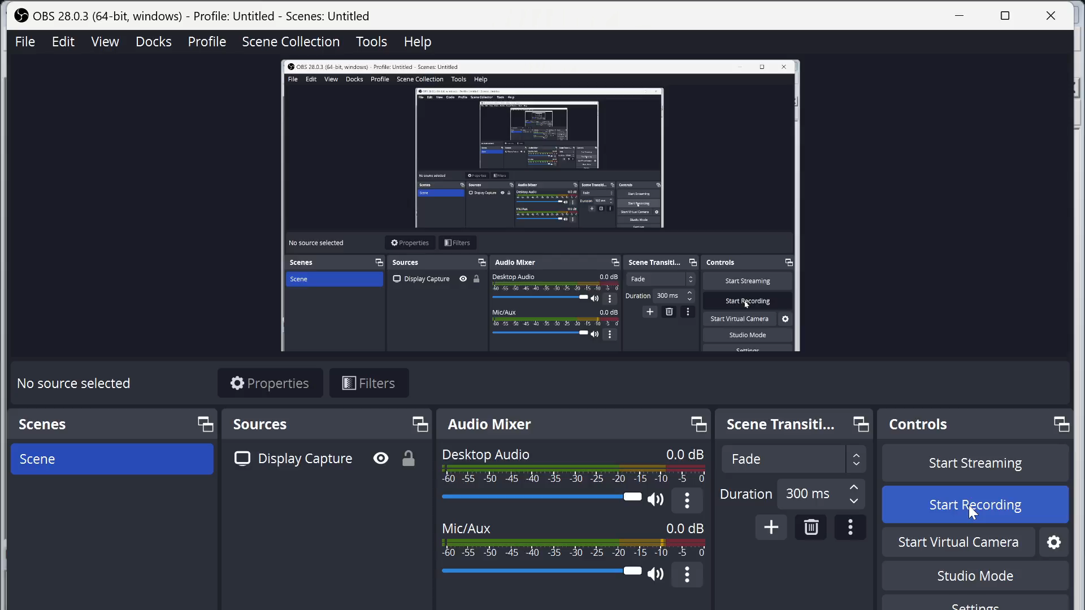

Slide 18
Major Takeaways
The same way a lack of genetic diversity will cause problems in the real world. A lack of solution variety will cause issues when trying to solve larger problems with genetic algorithms. Until I modified the way my sudoku program handled fitness, it couldn’t solve a single puzzle. I believe the modifications that I made to the fitness ranking algorithm along with increasing the mutation rate to 15% allowed the program attain the solution diversity threshold needed to have fighting chance at generating solutions to puzzles.

